Slide 1



Behavioural Insights on Bear Attractant Management in BC Campsites
Symposium: Human-Wildlife Coexistence in Agricultural Landscapes
Oct 16th, 2025

Slide 2
Collaborators and Support
The University of British Columbia
Sumeet Gulati
David J. Hardisty
Cole Burton
Rumi Naito
Sima Khanal
Agamveer Kalra
Raunaq Nambiar
BC Parks
Don Carruthers Den Hoed
Sharilynn Wardrop
Melanie Percy
Erin Kendall
Park Managers
Troy Davis, Manning Park
Ryan Turral, Cultus Lake
Michael Zavaglia, Cultus Lake

Slide 3
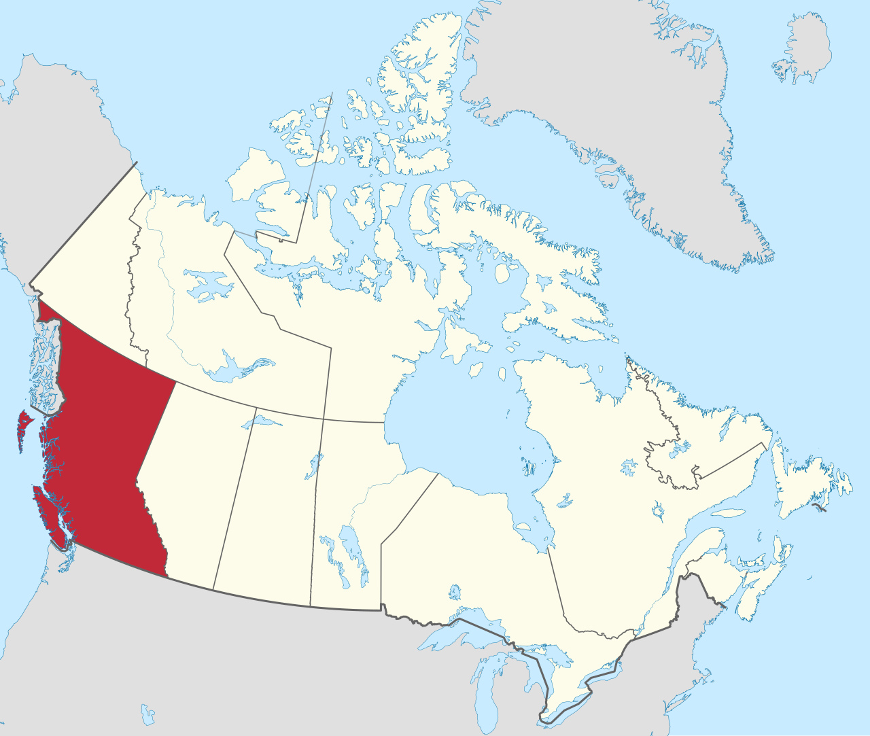
Lands
UBC Vancouver Campus
Musqueam
Squamish
Tsleil-Waututh
Manning Park
Stó:lō
Similkameen
Cultus Lake
Ts'elxwéyeqw
Soowahlie

Slide 4
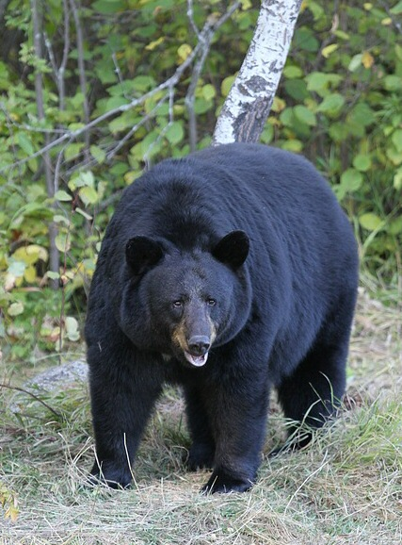
Human Bear Conflict: The Problem
Humans are increasingly encroaching on bear habitat (exacerbated by climate change)
Food and food odours attract bears, leading to conflict and the death of the bear
Around 500 bears are killed each year in BC
It is illegal to leave out bear attractants at campgrounds and homes near bear habitats, but people still do it (i.e., policy solution is in place, but not enough compliance)
Notes:
Image from https://en.wikipedia.org/wiki/American_black_bear#/media/File:01_Schwarzb%C3%A4r.jpg
CC BY-SA 3.0

Slide 5
Behavioural Insights Approach
Applying social science research (such as psychology and economics)
to encourage better choices for individuals and society
often used in public policy
Example: using defaults to increase household uptake of green energy

Slide 6
Research Question
What is the most effective and feasible way to improve human behavior and decrease unattended bear attractants?
Additional information? (Make it Easy, Attractive, Social, and Timely; EAST)
Financial incentive? ($10 gift card to Tim Hortons)
Social nudge? (Responsible camper sticker)

Slide 7
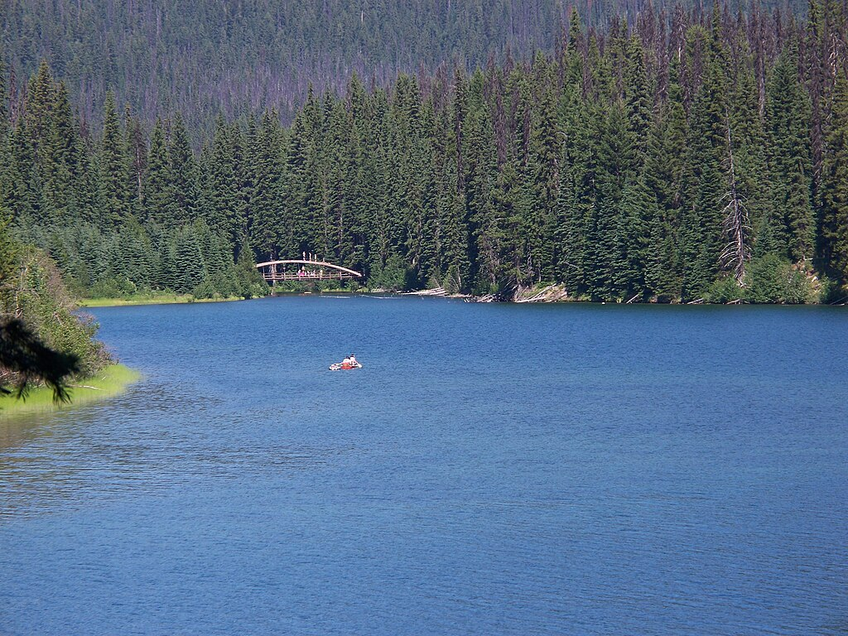
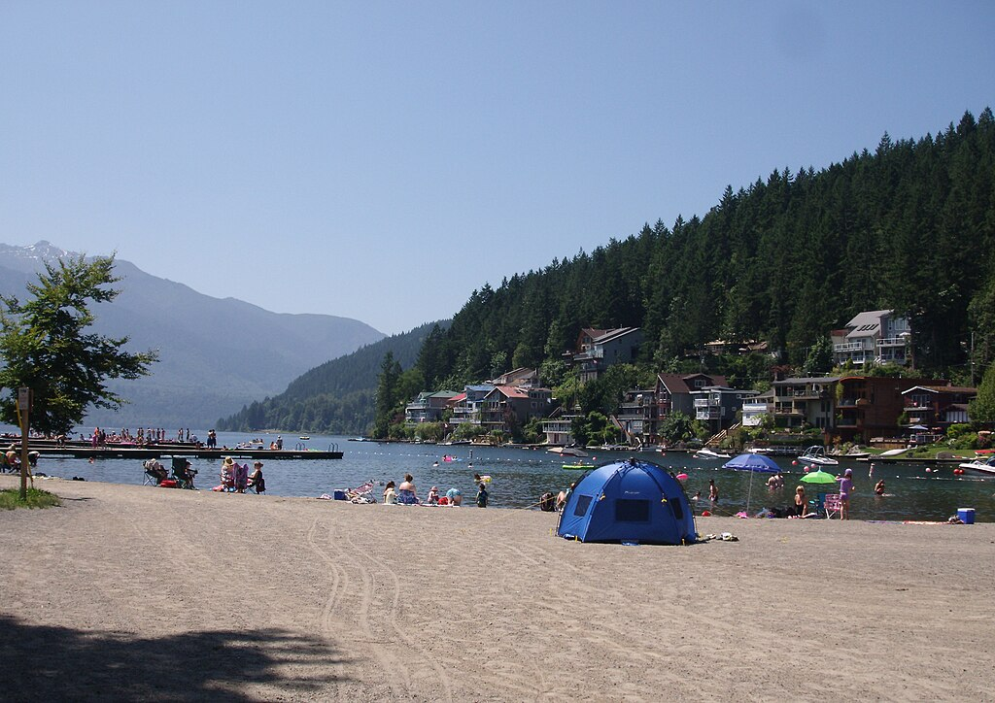
Two Quasi-Experimental Field Studies
Summer 2024: Manning Park, BC
Summer 2025: Cultus Lake, BC

Slide 8
Manning Park: Research Design
Condition 1 (C1): Control
No intervention provided (nothing beyond typical park signage about bears)

Slide 9
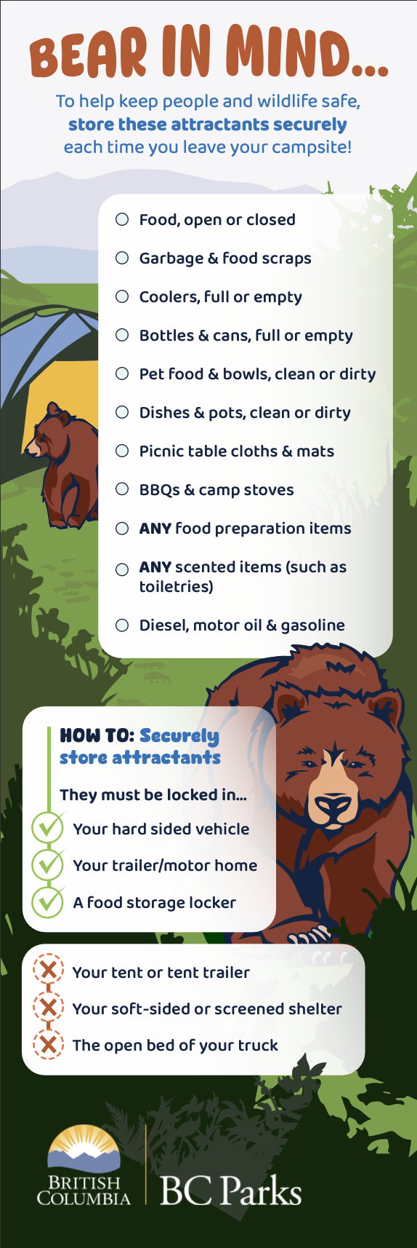

Research Design
Condition 2 (C2): Information only
Provide campsite visitors with a card containing information on bear-safe behaviors, a list of bear attractants, and how to securely store them.

Slide 10

Research Design
Condition 3 (C3): Information + Financial incentive
Provide campsite visitors with an information card and offer a cash reward for maintaining a “bare” campsite

Slide 11

Research Design
Condition 4 (C4): Information + Sticker
Provide campsite visitors with an information card and offer a “responsible camper” sticker reward for maintaining a “bare” campsite

Slide 12
Maning Park: Research Design
Interventions given to campers by our research assistants, shadowing park staff when they check in visitors (n=257 camping groups)
Data on bear attractant behavior collected by research assistants via observation each morning
Key outcome: Attractant violations (rated 0, 1 ,or 2)
Violation Score | Description
0 - No violations | No attractants recorded.
1 - Moderate Violations | At least one but no more than 3 attractant category violations observed, AND no severe attractant category (Food and Food Scraps, Garbage) violation observed.
2 - Severe Violations | 3 or more attractant category violations observed, OR at least one severe attractant category violation observed.

Slide 13
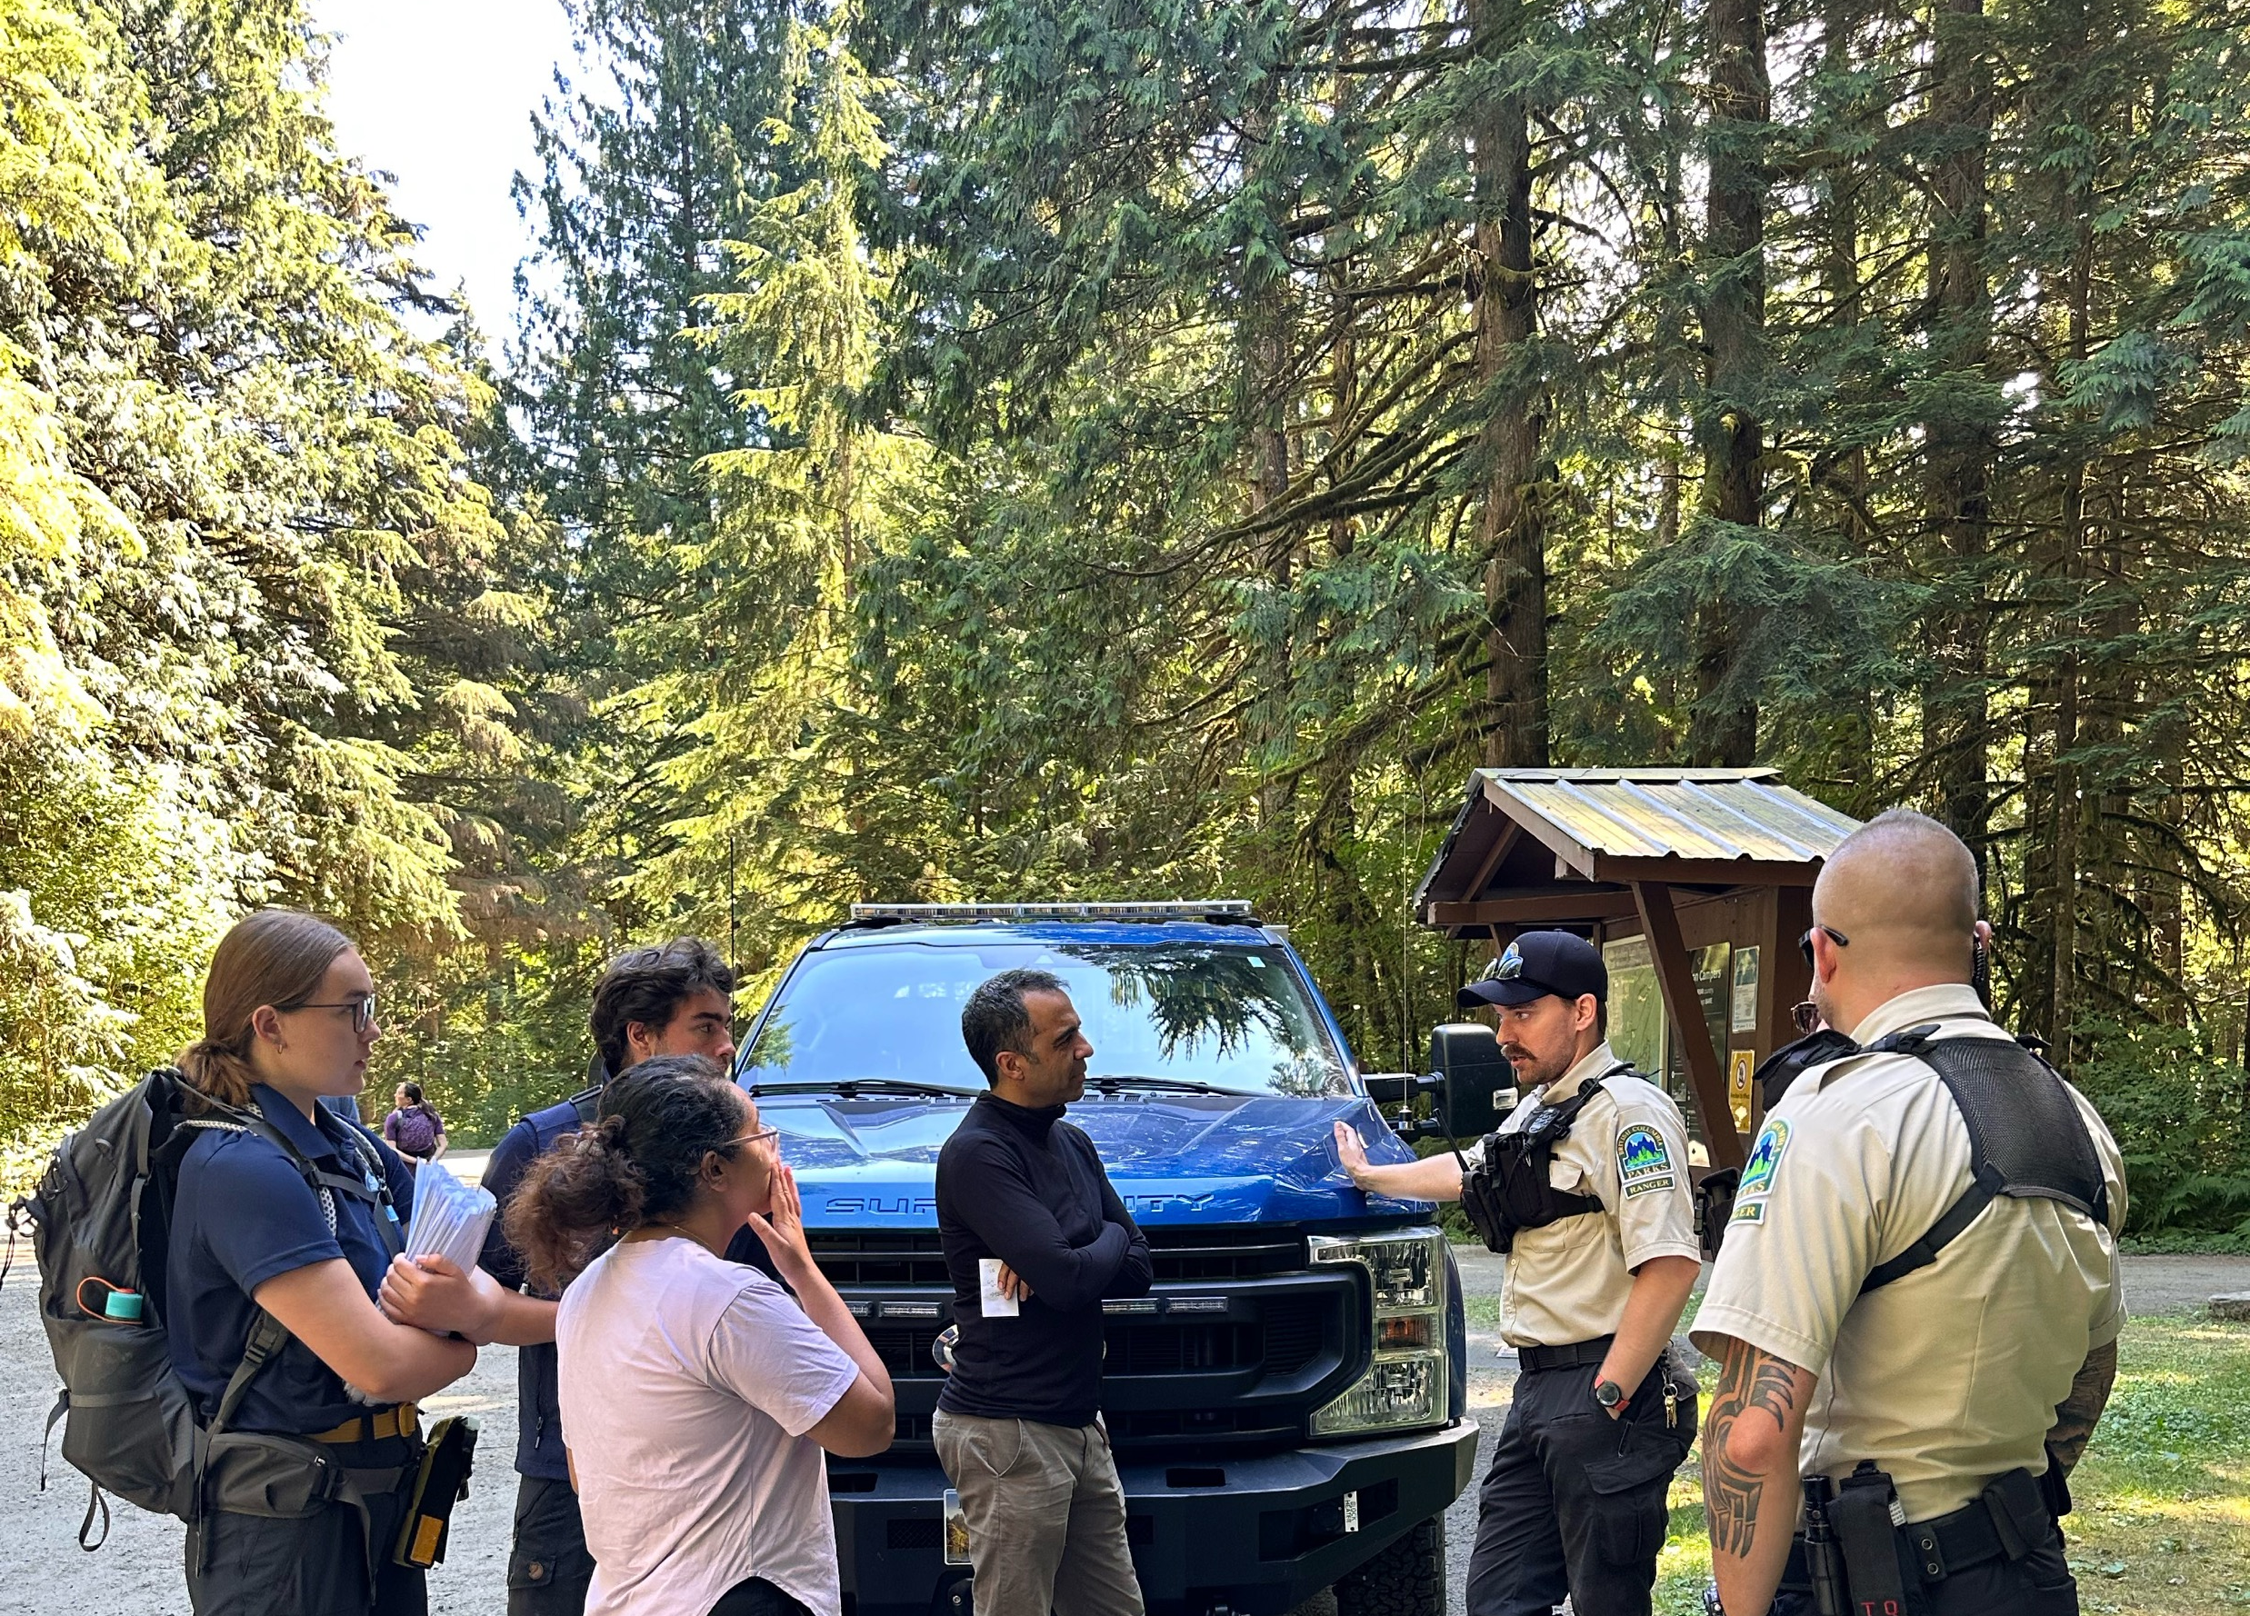
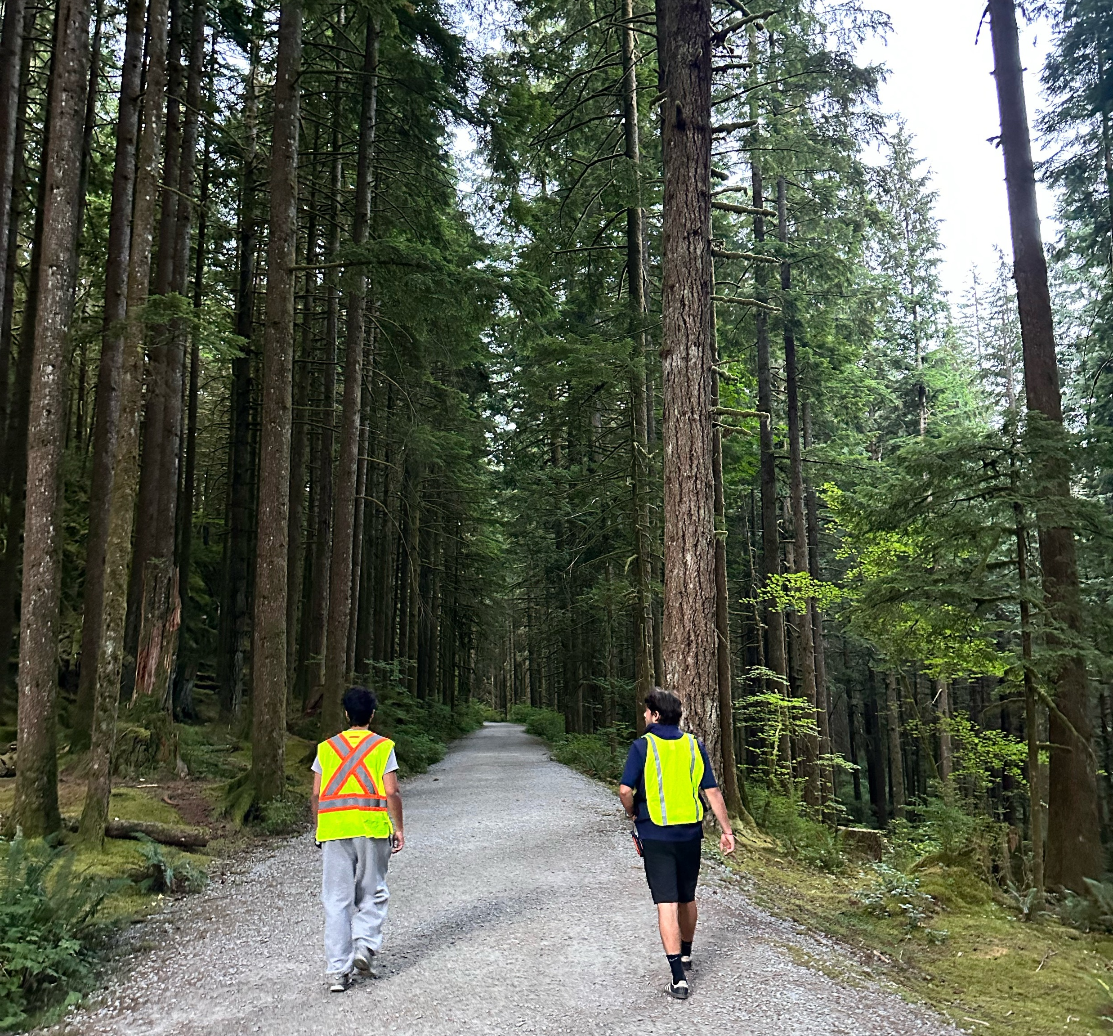
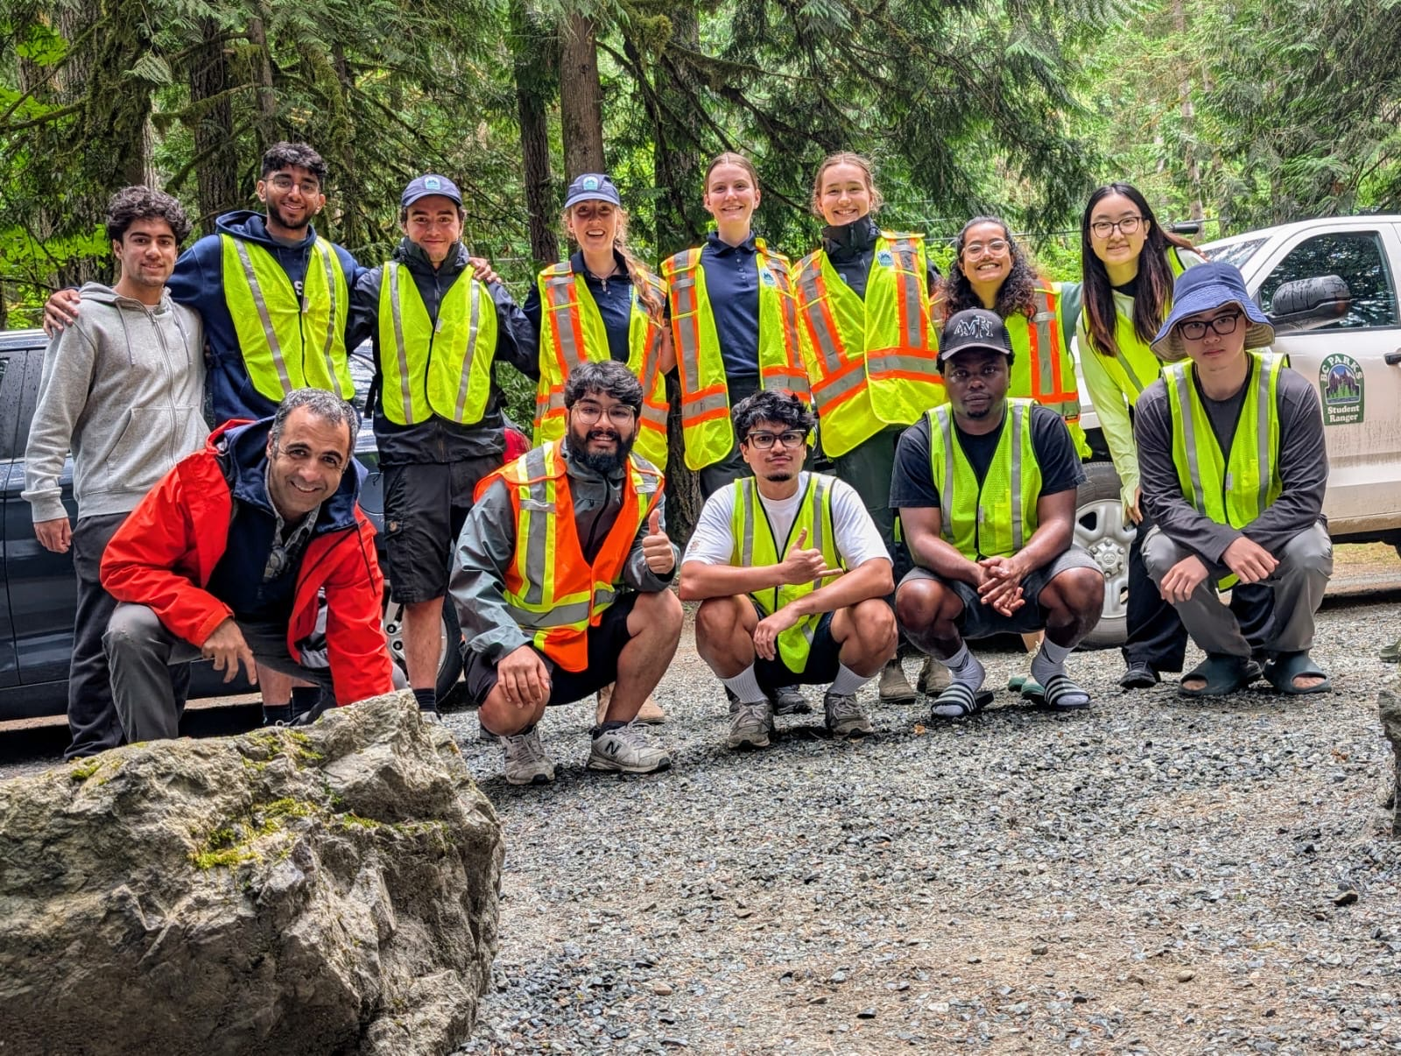

Slide 14
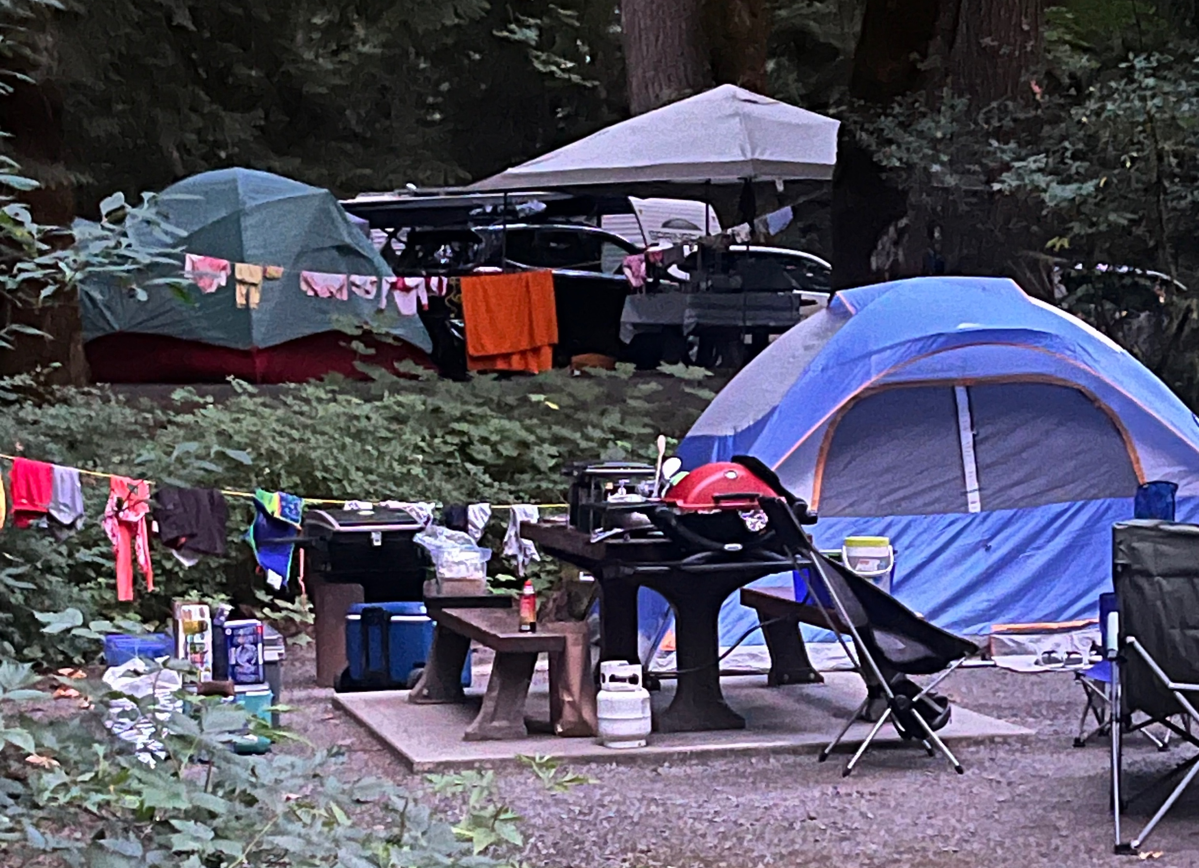
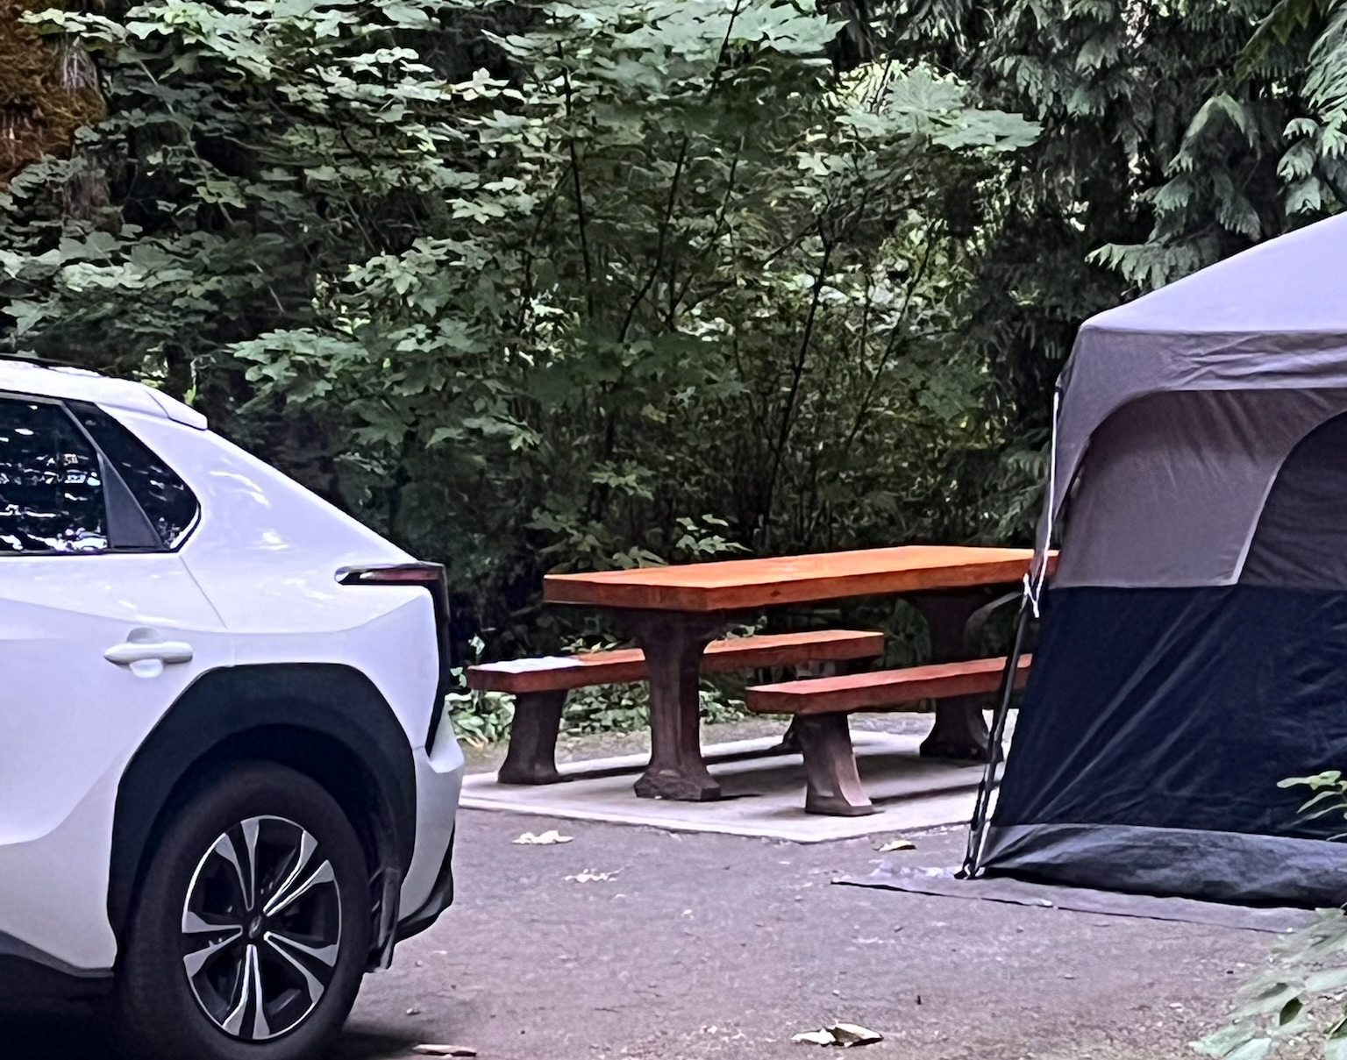
Dirty and Clean Campsites

Slide 15
Manning Park: Research Design
Condition 1 (C1): Control
Condition 2 (C2): Information only
Condition 3 (C3): Information (C2) + Financial incentive
Condition 4 (C4): Information (C2) + Sticker
Your prediction? Which condition is most effective for reducing violations?

Slide 16
Manning Park 2024: Results

Slide 17
Anecdotal Result
We did not collect any data on camper demographics, but our research assistants noticed something:
The sticker condition was especially exciting for families with children

Slide 18
Limitations
All conditions involved face-to-face discussions with campers, which is not feasible for most park operators
No “business as usual” baseline; all participants knew they were being observed
Limited sample size, only one park

Slide 19
Cultus Lake Campgrounds Experiment
One additional control condition added: Business as Usual (no interaction with the campers)
In other conditions: Minimal interaction (only drop-off materials)
5 conditions in total: Business as Usual Control Consent Information Information + Sticker Information + Gift Card

Slide 20
Cultus Lake Campgrounds Experiment
1585 camping groups observed for 15 days.
Block randomization within campsite loops, contiguous cluster assignment to reduce spillovers
Distance to garbage bins included as a potential confound/covariate
Observed campsite characteristics and collected survey data (not analyzed yet)
Pre-registered study, open data: https://doi.org/10.17605/OSF.IO/FK65J

Slide 21
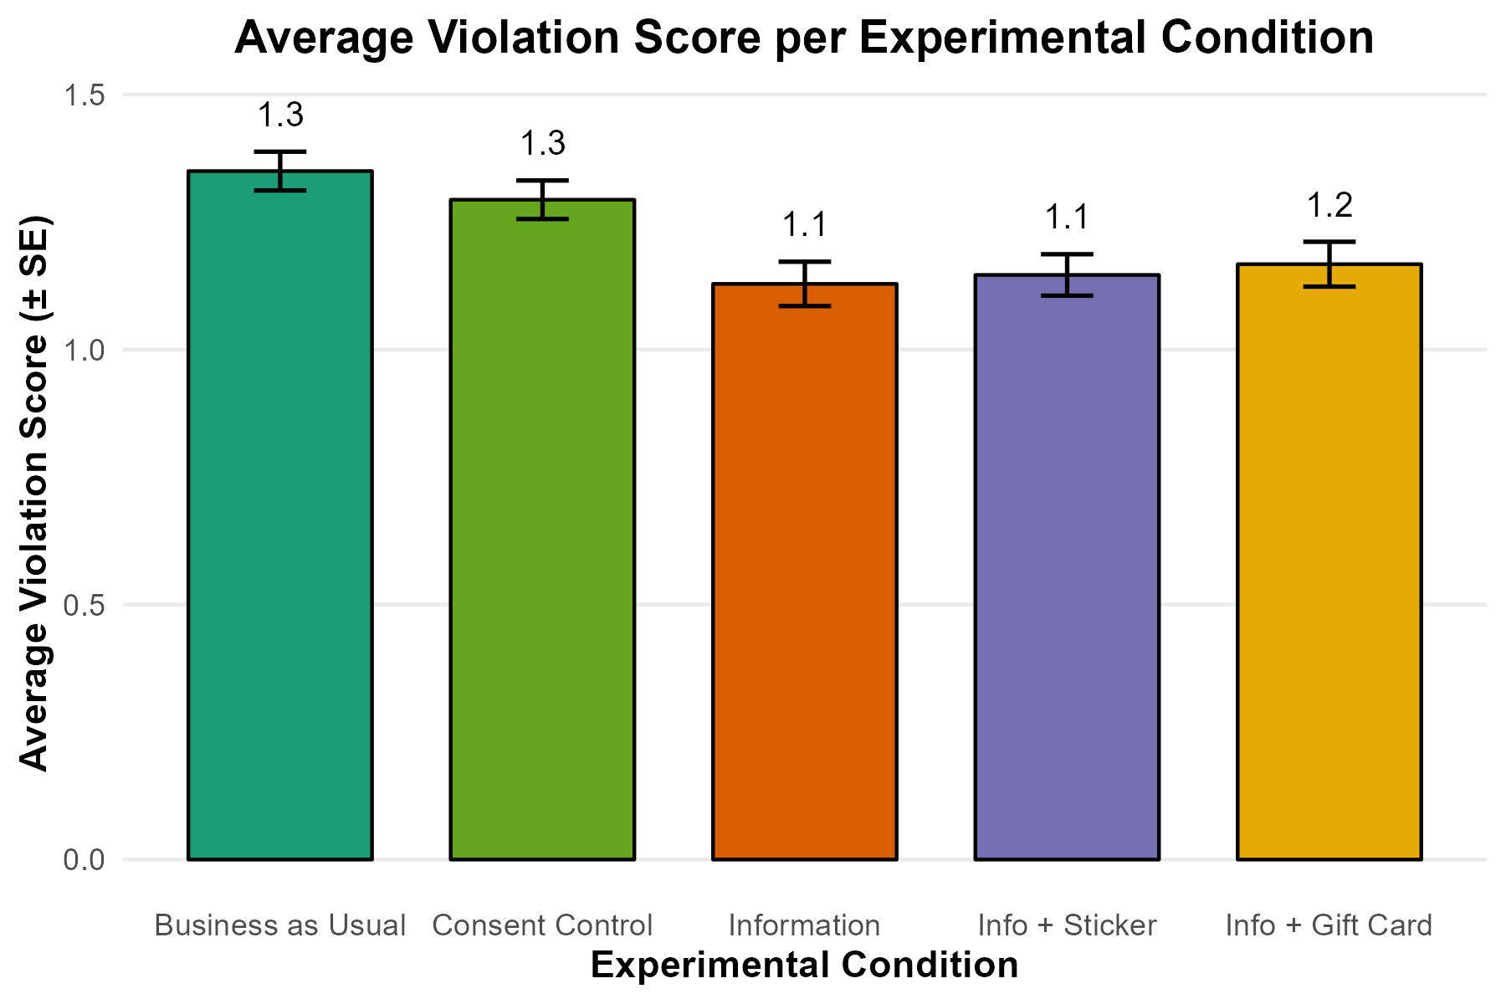
Cultus Lake 2025: Results

Slide 22
Key Takeaways
Attractive information, provided at the right Time and place, making the target behaviour Easy, was effective in two field studies
Little additional value of the $10 incentive or the sticker incentive
Data analysis is ongoing

Slide 23
Thank you!

